Slide 1
Introduction to the Raspberry Pi
MakerspaceCT

Slide 2
The Raspberry Pi Foundation
Founded in 2009, the Raspberry Pi Foundation was created in response to a decline of interest in computer science by students in UK schools, with the goal of fostering the computer science programming in education.
The Raspberry Pi Foundation has developed a series of low-cost computers using open standards, intended to be an easy and affordable for school children to get exposed to computers and programming.

Slide 3
What is the Raspberry Pi?
“Raspberry Pi” describes a line of low-cost ($10-$55 USD) computers produced by the Raspberry Pi Foundation
Due to its low cost, large community, and use of open source software, Raspberry Pis have exploded in popularity since the release of the Raspberry Pi 1 Model B in March, 2012 (yes, the Model B came before the Model A).
The most current high end versions (the Raspberry PI 3 Model B+ and Raspberry PI 4 Model B) have 64 bit CPUs, dedicated GPU’s (video), Ethernet and WiFi connectivity and 1 to 4GB of memory. (More than some Personal Computers from just 10 years ago.)
As of December 2019, more than 30 million Raspberry Pi units have been sold worldwide.

Slide 4
Raspberry Pi vs. Arduino
Adapted from MakeZine: (https://makezine.com/2015/12/04/admittedly-simplistic-guide-raspberry-pi-vs-arduino/)
Arduino is open standard microcontroller and support board. A microcontroller is a simple computer that can run one program at a time, over and over again. Arduino compatible microcontrollers are available from many manufacturers and in many formats. It is suitable for Real Time activities because the processor is committed to one task at a time.
A Raspberry Pi is a full general-purpose computer which can run multiple programs at one time. It uses a full operating system (often GNU/Linux based) and can connect to a monitor, mouse, keyboard and network. Unlike most “personal computers” it also has an easy to access expansion bus (General Purpose Input and Output - GPIO) which makes it easier to interface to electronics projects. Due to multitasking, it may not be suitable for Real Time activities.
Notes:
An Arduino board is best used for simple repetitive tasks: opening and closing a garage door, reading the outside temperature and reporting it to Twitter, driving a simple robot.
Raspberry Pi is best used when you need a full-fledged computer: driving a more complicated robot, performing multiple tasks, doing intense calculations (as for Bitcoin or encryption)

Slide 5
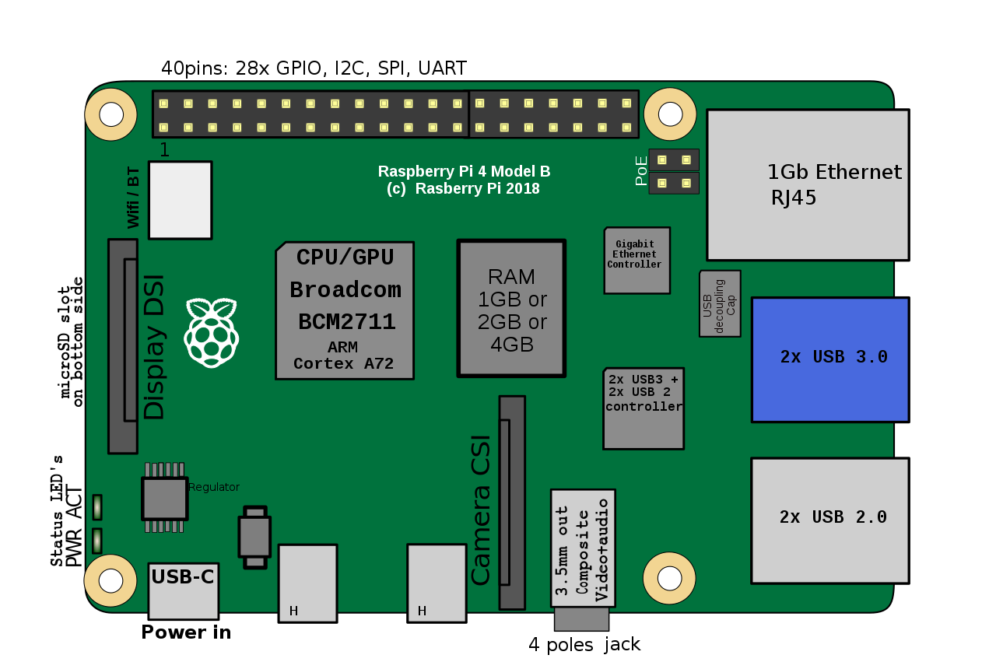
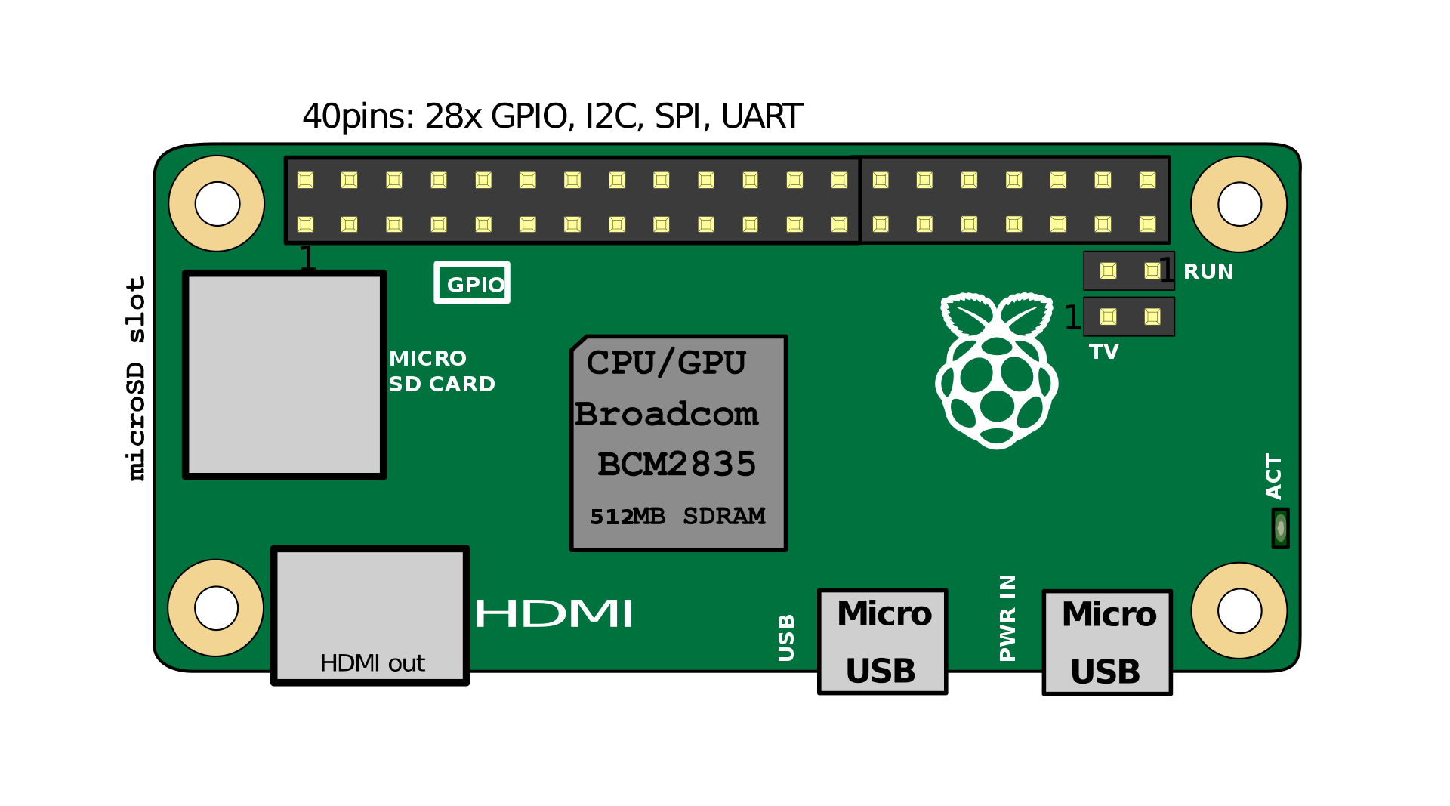
Which RasPi model?
Raspberry Pi 3 Model B+ and Raspberry Pi 4
Pros:
Faster Processor and more RAM
HDMI, Ethernet and USB connections
Cons:
Higher Power Consumption
More Expensive than RasPi Zero
Zero-series (small form factor - Raspberry Pi Zero, Zero W, Zero WH
Pros:
$10 or less,
low power consumption, tiny form factor, great for IoT
Cons:
Too slow for desktop use, requires adaptors for HDMI/USB
By Jstrom99 - Own work, CC BY-SA 4.0, https://commons.wikimedia.org/w/index.php?curid=83463602
Efa [CC BY-SA 3.0 (https://creativecommons.org/licenses/by-sa/3.0)]

Slide 6
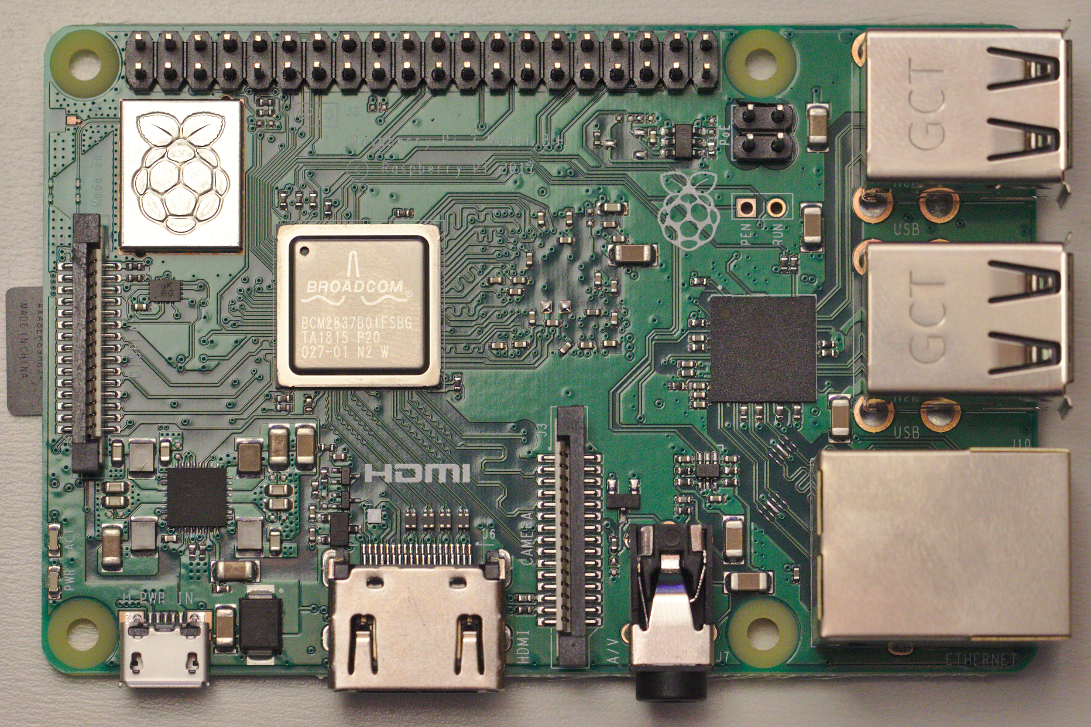
Raspberry Pi Setup - Connections
E
Plug In:
Keyboard and Mouse
Video
Network Cable (or use WiFi)
MicroSD Card (Storage)
40 Pin GPIO Ribbon Cable
When Ready To Start plug in Power (F. USB connector)
Note: There is no On/Off switch
A
D
C
F
B
File:Raspberry Pi 3 B+.jpg. (2019, July 5). Wikimedia Commons, the free media repository. Retrieved 05:33, November 28, 2019 from https://commons.wikimedia.org/w/index.php?title=File:Raspberry_Pi_3_B%2B.jpg&oldid=357124249.

Slide 7
Raspberry Pi Operating Systems
The Raspberry Pi requires a MicroSD or SD card for the operating system and standard internal file storage. An SD card must be purchased or created in order to boot up and run the Raspberry Pi.
There are two ways to create a bootable SD card:
NOOBS and NOOBS Lite
An easy to use operating system installer/recovery tool, sometimes provided on microSD cards sold with Raspberry Pi’s. Downloadable at https://www.raspberrypi.org/downloads/noobs/
Easier to install: simply copy the NOOBS files to the root of a FAT32 formatted microSD card, insert card, boot and select the OS you want.
Standard NOOBS (about 2.3GB) includes Raspbian, NOOBS Lite (about 37MB) will download OS’s from the Internet during the install.
Build a OS ‘image disk’ using a personal computer (as described at https://www.raspberrypi.org/documentation/installation/installing-images/README.md )
Download a ISO image of the OS formatted for the Raspberry PI.
Use an operating specific application (such as BalenaEtcher https://www.balena.io/etcher/ on the personal computer to transfer the ISO image to the SD drive.
Notes:
Many Pi OS options exist
NOOBS is an os/recovery manager that makes installation/reinstallation of Pi OS’s simple and straightforward, without the need to reflash the SD card.
(But it’s not trivial to get working - I’ve had more success with Raspbian images

Slide 8
Raspbian and other RasPi OSs
Standard Operating Systems Distributions
Raspbian - A GNU/LINUX Debian Distribution configured with popular tools is the most popular Raspberry Pi OS - It is our recommended OS
Ubuntu MATE - Ubuntu-based GNU/Linux Distro - is probably the next most popular
Special Purpose OS’s
Windows10 IOT Core - Windows 10 Universal Applications (aka Modern Apps from the Windows app store’) from Microsoft
Kali Linux - Digital Forensics & Penetration Testing specific distribution
OpenWRT - Lightweight Linux distribution for Networking/Routers (Note: Raspberry Pi communication ports are not ideal for routing)
And many more…
Note: GNU/Linux distributions (Distro’s) typically include the OS, a Graphical User Interface (GUI) and a selection of applications
Notes:
Numerous Linux flavors/distros exist

Slide 9
Installing The Operating System
Insert the MicroSD card in the slot on the bottom of the Raspberry pie (label facing down, contacts up toward the board) and plug in the power to turn the system on.
Follow the prompts to select the Country (United States), Language (American English) and time zone (New York) and check off ‘Use US Keyboard (just in case…)
For the purpose of the class, leave the default username of “pi” and password of “raspberry” (Security Alert!)
If there is a black section of the screen around the desktop, check off the box.
Connect to the WiFi network if needed,
SKIP, DO NOT RUN THE UPDATE routines at this time. (Security Alert! But it takes too long for the class to wait.)
Reboot if instructed

Slide 10
The Background of GNU/Linux, in a nutshell
Linux - a Unix-compatible kernel that runs on a 386 PC (a kernel is the foundation, the lowest-level component, of an operating system) - was built and released in 1991 by Linus Torvalds.
The GNU Project formed in the early ‘80s with the goal of creating a free alternative to UNIX, a then popular closed-source operating system from Bell Labs/AT&T. GNU is a recursive acronym that stands for GNU’s Not Unix.
The Linux kernel was paired with the GNU Project’s set of tools, drivers and programs to form a complete operating system. GNU/Linux Distros start there and mix in installation code, utilities and end user applications.

Slide 11
Raspbian Basics
Desktop Environment - A user friendly GUI shell
The Raspberry Icon in the upper left is the main menu
The Task Bar is on the top, default icons include:
The globe icon launches the Chromium Internet Browser (The Open Source root of Google’s Chrome browser.)
Folders opens the File Manager including ‘Find Files’ under the Tools menu
Black box with prompt opens the ‘Terminal’ aka Linux Command Line
Connect to a Network
Direct Ethernet connections usually start by themselves, otherwise use raspi-config from the command line or system menu
WiFi access easily configured by clicking the radio icon on the upper right corner

Slide 12
Raspbian Basics Continued
The Terminal - access to the GNU/Linux Command Prompt (aka BASH shell)
GNU/Linux is a command oriented OS, the GUI was added on to make it more “user friendly” but the GUI in not required for OS functions.
Most commands are in lowercase - UPPERcase and lowercase matter!
Some commands need extra permissions (sudo - Super User Do - pronounced Sue-Doh).
The interactive command lines keeps an editable history - use the up and down arrow keys to go up and down in the list, left and right keys etc. to edit the line and enter to accept the line (and avoid typing!)
Commands include:
Running programs (sudo raspi-config, python3, minecraft-pi, nano, zip)
Installing and updating software (sudo apt-get update, sudo apt-get install python3)
Disk and file commands (dir, ls, free -h, mkdir, chdir, pwd, etc.)
Documentation (man i2cdetect, man man , man gpio, <command> --help)

Slide 13
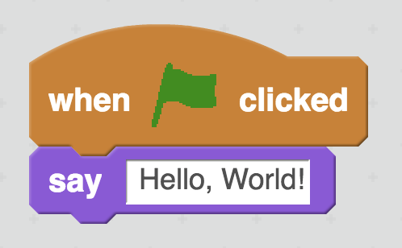
Writing the traditional simple first program (3 Ways)
Bash -> Linux Command Scripts - automating commands and running programs
The BASH Shell can run “shell scripts” - text file “programs” that run a series of commands, one line at a time
Open Terminal/Command session
Type “echo Hello World”
Scratch2 -> Block-based Drag and Drop programming
Run application Scratch2 (from Menu or Terminal/Command line)
Enter blocks (/Events/When Flag Clicked and /Looks/Say text)
Click on the green flag
Python -> Established cross-platform language with support for more complex tasks and functions.
Run application python3 (from Menu or Terminal/command line)
Type the following at the prompt: print ("Hello World") then press Return/Enter key
exit()
Notes:
We’re going to touch on three (of many) ways of creating a program/workflow in Raspbian.
Bash, Bourne-again-shell, is a programming language/shell interpreter that allows for creation of linux scripts.
Scratch/Scratch2 are designed to teach programming concepts without necessitating knowledge of programming syntax. Users drag and drop blocks to create logic. Targeted at the creation of simple games.
Python is an established cross-platform language with support for more complex tasks and functions.

Slide 14
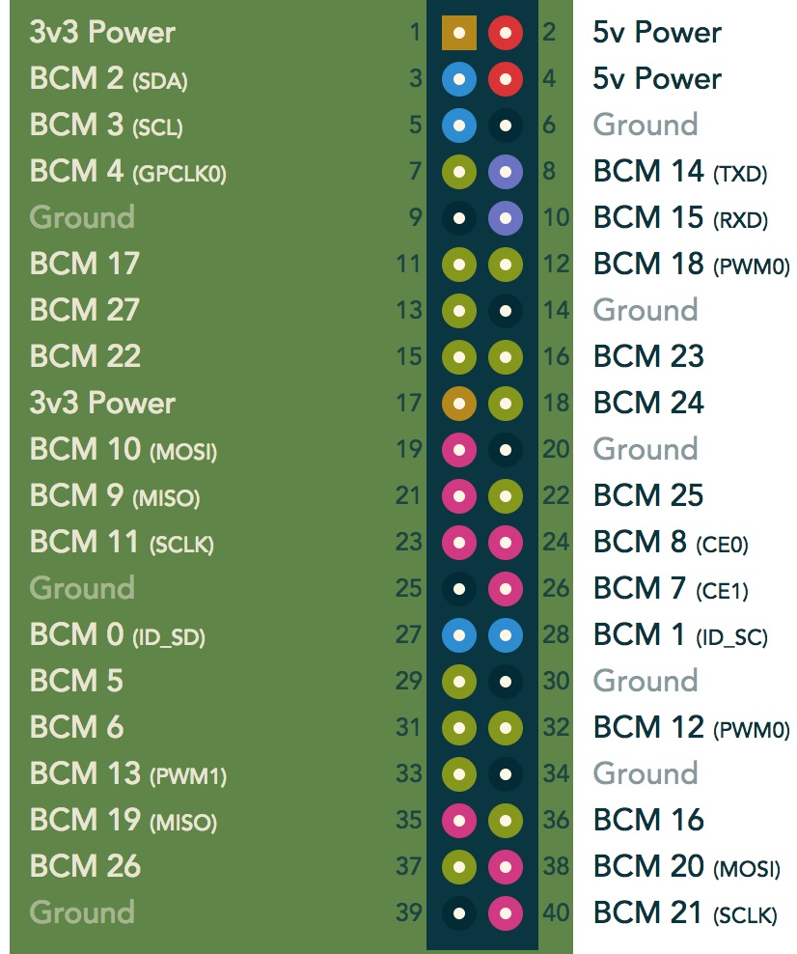
Stuff you can’t do on your laptop: GPIO (General Purpose Input-Output)
40-pin connector that allows for straightforward interfacing to 5v or 3.3v electronics hardware - under the control of the Raspberry Pi software!
‘Software Interfaces’ are needed to talk to these ports, including:
WiringPi, for interaction from the command line and BASH scripts: http://wiringpi.com/the-gpio-utility/
An alternative chart is available at: https://learn.adafruit.com/assets/28879
Image: https://pinout.xyz
Notes:
There is a easier to read chart at https://learn.adafruit.com/assets/28879

Slide 15
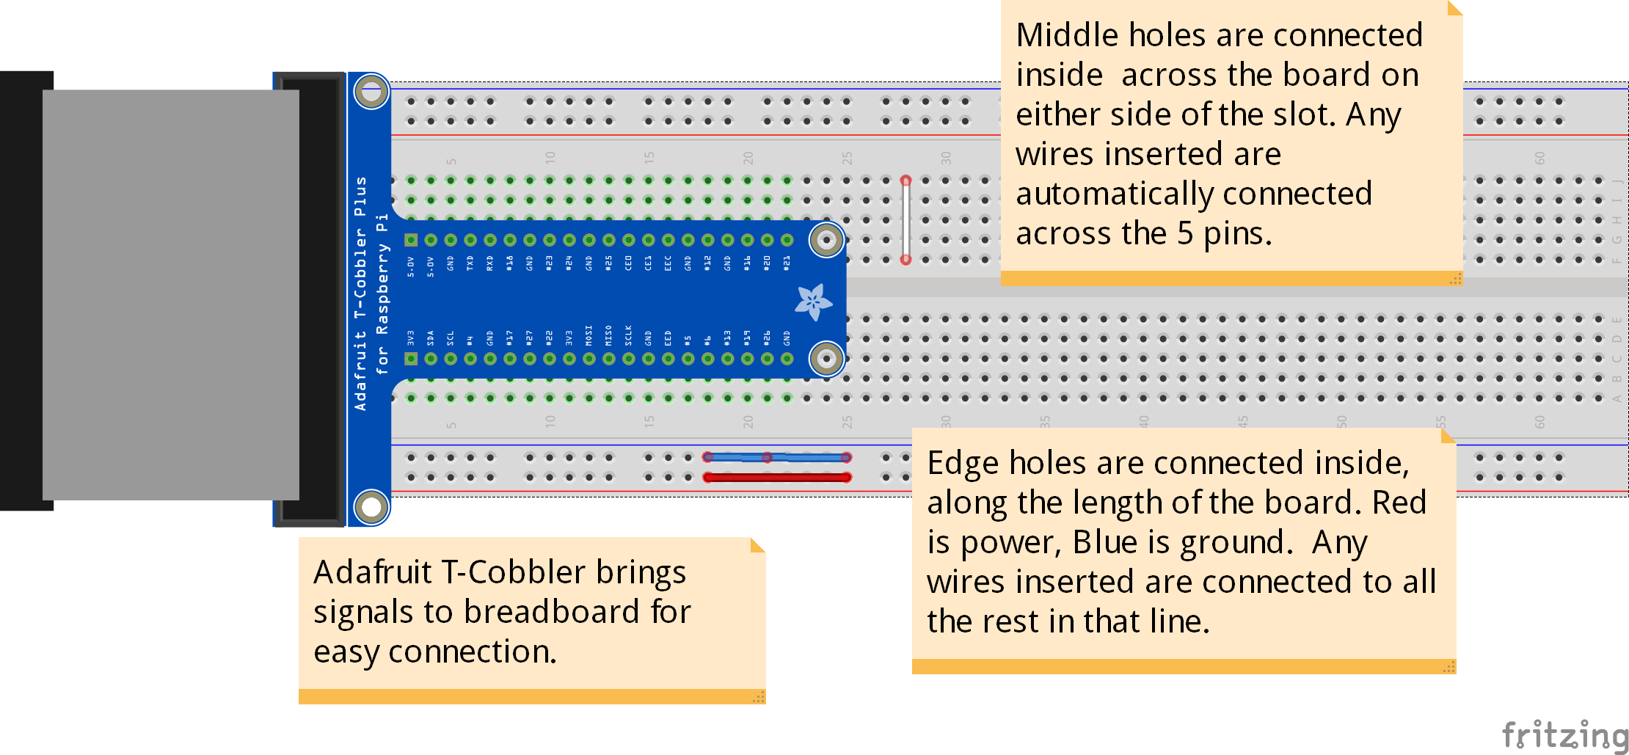
Breadboard Basics and a Helper
Fritzing is an amazing tool for documenting breadboard circuits and converting them to circuit boards. https://fritzing.org

Slide 16
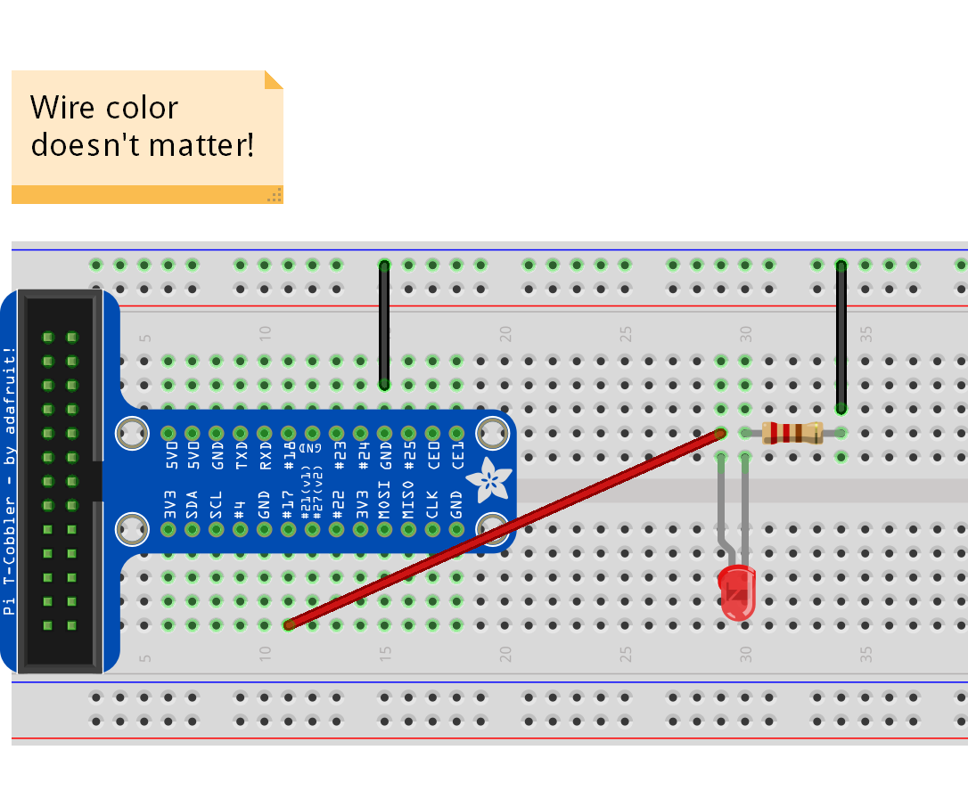
Breadboard connections for controlling a LED
Connections for ‘Blinky” LED control:
Ribbon Cable from RasPi to T-Cobbler provides easy access to all signals.
Any ground (GND pin) connected to one end of an about 330 ohm resistor.
The other end of the resistor connects to the straight (short) side of LED ***.
The bent (long) side of LED connects to Pin 11 (BCM 17) from the RasPi (note: 17 is right next to 27!)
Wire color doesn’t affect function, pick ones that work for you.
Part placement isn’t critical, this is just one way to position parts and route wires.
Notes:
Wire color doesn’t matter, and part placement isn’t important, this is just one way to position parts and route wires.

Slide 17
Blink a LED - Three Ways
Bash -> Native Linux Script, great for simple and quick projects
Scratch (2) -> Block-based programming (syntax-free)
Python -> Established cross-platform language with support for more complex tasks and functions.
I bet you can you think of another way to blink the LED on and off. We could simply connect the LED to pin 1 (3 volts) and it would light. Disconnect and it goes off. We could even add a button in that circuit and the button would control the LED. Sometimes computers make easy things harder....

Slide 18
bash
Run `gpio readall` to view status of GPIO pins.
If it’s not available install it (sudo apt install wiringpi)
If it gets an error saying “Unable to determine board type” then install update from: http://wiringpi.com/wiringpi-updated-to-2-52-for-the-raspberry-pi-4b/
Run ‘man gpio` to view documentation for gpio.
(-g option says to use BCM GPIO numbers)
Run `gpio -g mode 17 out` to set pin 17 to output.
Run `gpio -g write 17 1` to set the value of pin 17 to “1” (HIGH) On
Run `gpio -g write 17 0` to set the value of pin 17 to “0” (LOW) Off

Slide 19
Create bash ‘shell script’ (.sh extension)
Open Terminal
Run `nano lightonoff.sh’ to open the nano editor and create a file
Type in the following lines:
#!/bin/bash
gpio -g mode 17 out
echo “light On”
gpio -g write 17 1
sleep 1s
echo “light Off”
gpio -g write 17 0
Use the Ctrl-o key combination to write the file out
Ctrl-x to exit
Run ‘chmod +x lightonoff.sh’ to allow executing the file
Run ‘bash lightonoff.sh’ to run the script
Politics, Religion, and Text Editors: (Three things polite people don’t talk about ) and programming languages…
Notes:
Linux text editors create an interesting controversy in the community. Many people have favorites and will aggressively tell you why their favorite is the best.
Are there differences in feature sets? Absolutely. At the end of the day, though, they’ll all edit text.

Slide 20
Create looping BASH script
Run `nano lightonoff.sh’ and change the file:
#!/bin/bash
gpio -g mode 17 out
gpio -g write 17 0
sleep 0.5s
for (( i = 1; i < 6; i++ ))
do
echo “light Off” $i
gpio -g write 17 1
sleep 1s
echo “light Off”
gpio -g write 17 0
sleep 1s
done
Use the Ctrl-o key combination to write the file out, Changing the name to ‘looponoff.sh’
Run ‘chmod +x looponoff.sh’ to allow executing the file
Run ‘bash looponoff.sh’ to run the script
Notes:
Linux text editors create an interesting controversy in the community. Many people have favorites and will aggressively tell you why their favorite is the best.
Are there differences in feature sets? Absolutely. At the end of the day, though, they’ll all edit text.

Slide 21
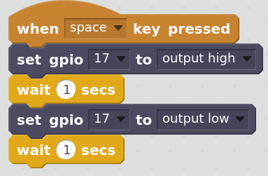
Scratch (version 2)
Open Scratch2 (Menu->Programming->Scratch2)
Add GPIO extension library
/Scripts/more blocks/”add an extension”
Select ‘Pi GPIO’ and hit Enter
B. Create Scratch program
Grab and move /Scripts/Events/”when space key pressed” to the work area
Grab and move /Scripts/More Blocks/”set gpio” and set under ”event”
Change number to 17 and keep Output High
Grab and move /Scripts/Control/”wait 1 secs” and set under “set gpio”
Grab and move /Scripts/More Blocks/Set gpio and set under ”wait”
Change number to 17 and set “output low”
Grab and move /Scripts/Control/”wait 1 secs” and set under “set gpio”
C. Run Program by pressing the <space bar>

Slide 22
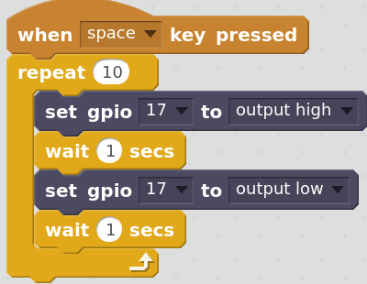
Scratch with a loop
A. Update Scratch program
Grab and disconnect all the set and wait blocks from the event
Grab new /Scripts/Control/”Repeat” block and set it under ‘When Space...”
Grab and move all the set and wait blocks and set inside the Repeat loop
B. Run the code by pressing the <spacebar>
If time, explore changing repeat and wait times, adding cat actions, etc.
Remember to Exit Scratch! – it’s a cpu/interrupt hog!

Slide 23
Python3 - Using the Thonny Python IDE
Open Thonny (Menu/Programming/Thonny Python IDE
or Thonny on command line)
Click on New to open a new working area
Enter the following code into the editor (type or copy and paste)
import RPi.GPIO as GPIO
import time
GPIO.setmode(GPIO.BCM) #use BCM pin numbering to match T-Cobbler board.
GPIO.setup(17, GPIO.OUT)
GPIO.output(17,True)
print("On")
time.sleep(5)
GPIO.output(17,False)
print("Off")
GPIO.setup(17, GPIO.IN) #resets pin to avoid error messages
Click on the Run icon to run the program (give it a name on the first run)
Note: In Python, The “#” delimiter marks the rest of the line to be ignored, it doesn’t interpret the following test.

Slide 24
Python loop and function
example
#! /user/bin/python3
import RPi.GPIO as GPIO
import time
GPIO.setmode(GPIO.BCM) # use BCM pin numbering to match T-Cobbler board.
GPIO.setup(17, GPIO.OUT) # use GPIO 17 to connect the LED
# blink count times, delay starts at pauseStart seconds, wait ramp second less each loop
def BlinkRampDown(count,pauseStart, ramp):
print("Loops:",count, "Delay at start:", pauseStart, "Ramp:", ramp)
pause = pauseStart
for i in range(0,count):
GPIO.output(17,True)
time.sleep(pause)
GPIO.output(17,False)
time.sleep(pause)
pause = pause - ramp
if (pause <= 0):
pause = 0
# Experiment with various calls
BlinkRampDown(10,1,0.1)
BlinkRampDown(20,0.25,0.015)
BlinkRampDown(10,0.25,-0.1)
GPIO.setup(17, GPIO.IN) #resets pin to avoid error messages
Remember:
Indentation is important!

Slide 25
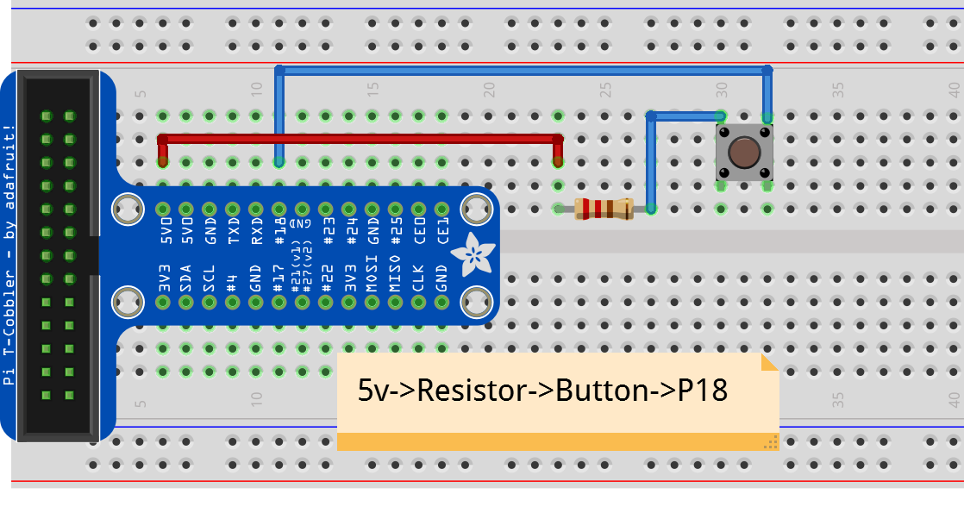
Adding/Wiring a Button
Leave your LED set up, we’re going to keep using it
Add a Button and connect one side to Pin 12 (GPIO18)
Add a 330 ohm Resistor between the other leg of the button and Pin 2 (5 volts)

Slide 26
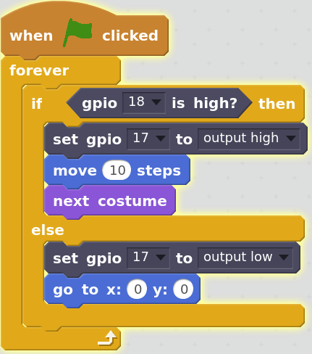
Scratch Button Reader
Open Scratch2 (Menu->Programming->Scratch2)
B. Create Scratch program
Event/when flag clicked
Control/loop forever under when
Put control if-else in forever loop
If condition <More/GPIO 18> is high then
Inside then:
Set gpio 17 to output.high
Move 10 steps
Next costume
Inside else
Set gpio 17 to output.low
Go to x:0 y:0
Run the program by clicking on the flag
Press the button to see it work

Slide 27
Python Button Reader
import RPi.GPIO as GPIO
import time
GPIO.setmode(GPIO.BCM) #use BCM pin numbering to match T-Cobbler board.
# Set GPIO18 as an input pin and set initial value to be pulled low (off)
GPIO.setup(18, GPIO.IN, pull_up_down=GPIO.PUD_DOWN)
GPIO.setup(17, GPIO.OUT) # our LED is still connected to GPIO 17
GPIO.output(17,False) # Turn the LEd off if it’s on
while True: # Run forever
if GPIO.input(18) == GPIO.HIGH:
print("Button was pushed!")
GPIO.output(17,True)
else:
GPIO.output(17,False)
GPIO.setup(17, GPIO.IN) #resets pin to avoid error messages

Slide 28
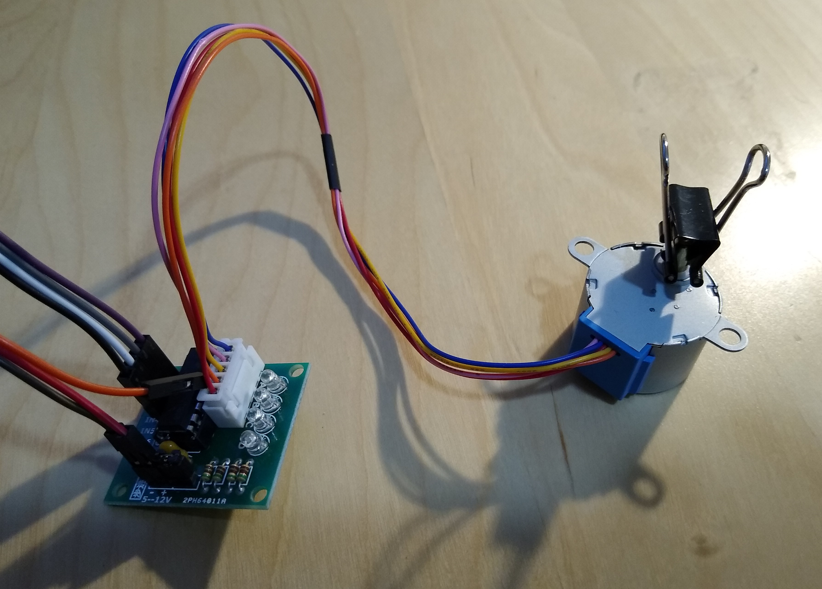
Stepper Motor Setup
Stepper Motor 28BYJ-48
Stepper Controller Board
IC ULN2003APG
4 clear LEDS
White 5 pin connector
IN1 to IN7
Power - and + (5--12V)
Plug white 5 pin cable from Motor to controller
Connect IN1 to GPIO 5
Connect IN2 to GPIO 6
Connect IN3 to GPIO 13
Connect IN4 to GPIO 19

Slide 29
Stepper Motor continued
Connect Power Cables
“-” to ground on breadboard
‘+” to +5 on breadboard
Go to: https://github.com/gavinlyonsrepo/RpiMotorLib/blob/master/RpiMotorLib/RpiMotorLib.py and copy the file RpiMotorLib.py (Or other locations as it may be available during class)
Open Thonny, open a new file, and paste library into editor
Save the file as RpiMotorLib.py into your current python directory (the default folder)
Open a new file and Copy in the short test program from the next page
Run it
Change some parameters and run it again
Notes:
Should be able to “pip install RpiMotorLib” but didn’t work on my system,
wget easier option?

Slide 30
Python Stepper Motor Test program
import RPi.GPIO as GPIO
import time
import RpiMotorLib
GpioPins = [5, 6, 13, 19] # GPIO pins to the controller
mymotortest = RpiMotorLib.BYJMotor("MyMotorOne", "28BYJ")
startTime = time.time()
# Call Syntax: motor_run(gpiopins, wait, steps(512 = 360 degrees),
# ccwise(False = clockwise), verbose, steptype(”full,"half" or ”wave”), initdelay)
mymotortest.motor_run(GpioPins , .002, 256, False, False, "full", .0005)
endTime = time.time()
print(f'Elapsed time in seconds {endTime - startTime:5.3}')
# avoid errors when running next program
GPIO.cleanup()

Slide 31
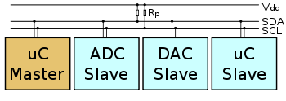
I²C - Inter-Integrated-Circuit (pronounce eye-squared-see)
I2C is a very common multi-master, multi-slave, serial protocol which uses a two-wire interface to connect devices like microcontrollers, I/O interfaces and other similar peripherals in embedded systems. (Typically 100kbits/sec up to 1 meter)
A Serial connection uses fewer wires than a Parallel connection, especially handy when connecting to multiple devices.
Each I2C slave device has a unique address.

Slide 32
Updating/Installing Software Packages in Raspbian
monday
The `apt` package manager is the easiest way to install software.
Syntax of the command:
Prefixing a command with ‘sudo’ causes it to be run as the root user (superuser).
“apt” is the name of the package manager.
“install” is what you want apt to do to the package you name next.
“i2c-tools” is the name of the Package to be installed.
sudo apt install i2c-tools
Notes:
http://www.circuitbasics.com/raspberry-pi-i2c-lcd-set-up-and-programming

Slide 33
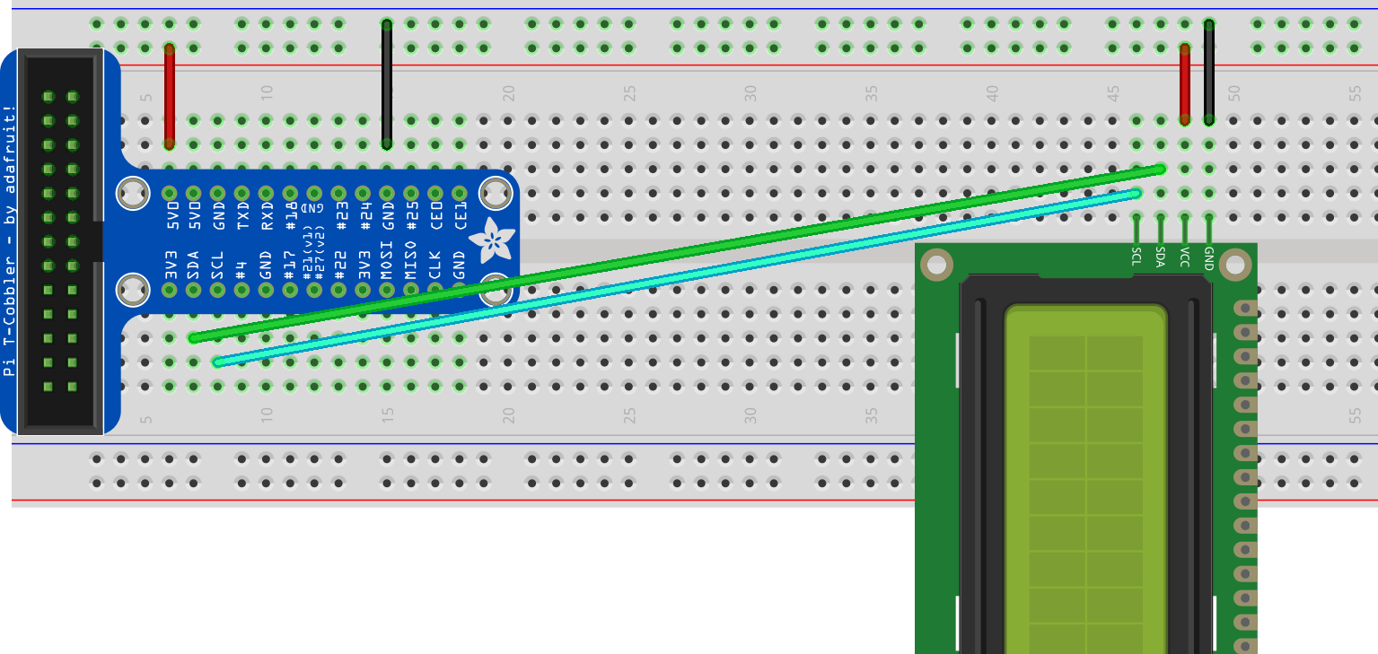
Wire the LCD module
GND goes to Ground
VCC goes to +5 Volt
SDA goes to SDA (Pin 3)
SCL goes to SCL (Pin 5)

Slide 34
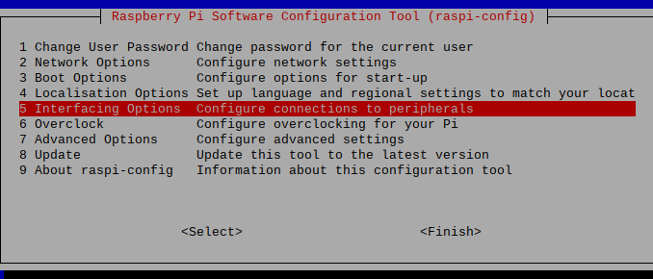
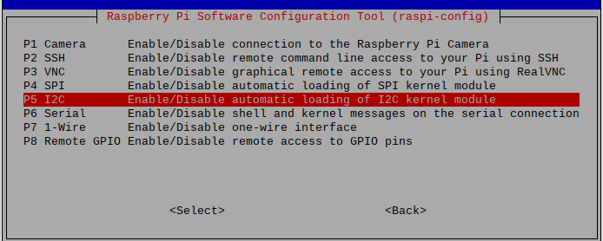
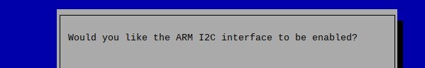
Enable I²C on the Raspberry Pi
Run sudo raspi-config
Select #5 Interface Options
Select #P5 I2C
Select <Yes>
Select <ok>
Select <Finish>

Slide 35
Ensure the SMBus and i2c software is loaded and
Find the address of the i2c device
Check that the SMBus software for Python is installed
sudo apt install i2c-tools
sudo apt install python-smbus
Detect the address of the LCD
Run “i2cdetect -y 1”
The address will show on the grid as something other than “--”, write down the number.

Slide 36
Writing a message to a LCD from Python
Open the LCD1602_guide.md file from https://github.com/MakerspaceCT/raspberry_pi_intro/blob/master/LCD1602_guide.md
Find the section labeled: “Install the Python I2C Library”
Copy and paste the first section of Python code into Thonny
Edit the BUS (probably BUS = 1) and ADDRESS values on lines 18 and 22.
Save the driver file as “I2C_LCD_driver.py”. This file name must be exact (without the quotes).
Create a python program to write to the LCD, save and run it.
Extra challenges:
Show the count of button pushes on the LCD
Show a list of quotes, one at a time. Push the button to change the text?
Push button to light up led, move characters along screen
import I2C_LCD_driver
from time import *
mylcd = I2C_LCD_driver.lcd()
mylcd.lcd_display_string("Hello World!", 1)

Slide 37
How to host a web site on your Raspberry Pi
As documented at: https://www.raspberrypi.org/documentation/remote-access/web-server/ both Apache and NGINX are officially available for the Raspberry Pi . We will install a local NGINX server for this class as it tends to require less resources.
Note: It is unlikely that these systems will provide the capacity desired for a public web site, but if you do provide public access be sure to lock down your connection with a firewall and router rules that only allow the required access.
It is a good practice to ensure that only one web server is installed on a system, run the following to ensure Apache is not installed:
sudo apt-get remove apache2
Let’s follow the foundation’s documented process at: https://www.raspberrypi.org/documentation/remote-access/web-server/nginx.md

Slide 38

Questions about the class? Email Drew at drew@drewgates.com or Chuck at VenterCE@gmail.com
Thank you!

